Slide 1
React – State and Props
2021

Slide 2
Part … (I‘ve lost count)
React Routing
Basics for Context API
React Props
React State

Slide 3
We’re starting with Routing, because it’s simple.

Slide 4
There’s no Routing in React
Told you it’s simple.

Slide 5
Let’s really start with Context

Slide 6
…React Context is somewhat complicated
We’ll save it for the end.

Slide 7
State is simple. Let‘s start with State.

Slide 8
But Props are even simpler! So props to props!
We have seen this so far.
class Todo extends React.Component { render() { <div> <h2>{this.props.title}</h2> <p>{this.props.desc}</p> </div> } }

Slide 9
Question: where does this.props come from?
class Todo extends React.Component { render() { <div> <h2>{this.props.title}</h2> <p>{this.props.desc}</p> </div> } }

Slide 10
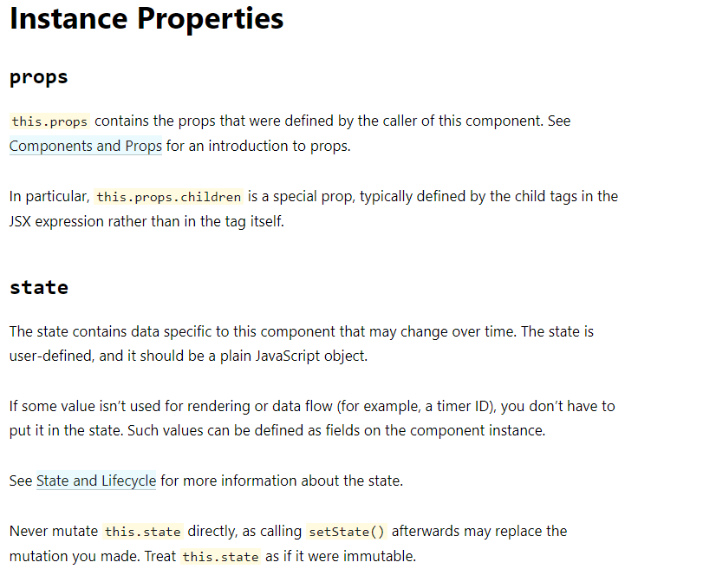
React.Component
…from React Homepage

Slide 11
That means that every component has „State" and „Props".
const Hello = (props) => <span>Hello, ${ props.name }</span>; class Hallo { render() { return <h1>Hallo ${ this.props.name }</h1>; } }

Slide 12
props.children
One specific property is props.children
It contains all of the nested elements and components
Example

Slide 13
Props are readonly. State is for us to work with.

Slide 14
We use Props, to get information from outside.
const Todo = (({ title, desc }) => <span>{ title } - { desc }</span>); const App = () => <div> <Todo title="Props" desc="Learn about props" /> <div>;
<App> controls which Props <Todo> has.

Slide 15
So then, how do we work with State?
When we extend React.Component we get State automatically, just like Props.
Every React component (even functional) has these, internally.
Stackblitz
class Todo extends React.Component { state = { // Set component state initially like this done: false, } toggleDone() { this.setState({ done: !this.state.done }); } render() { return <div> <h1>{ this.props.title }(status: {this.state.done ? 'done' : 'pending'})</h1> <input type="checkbox" defaultChecked={this.state.done} onChange={() => this.toggleDone()}/> </div> } }

Slide 16
State is local for a component and we can change it at will
Example
class Todo extends React.Component { constructor(props) { super(props); this.state = { done: props.done } } doTask() { this.state.done = true; } render() { return <div>...</div> } }

Slide 17
We still need to treat it as readonly!
For changing the state, we need setState method
// Wrong this.state.done = false; // Right this.setState({ done: false });

Slide 18
If we don‘t use setState to change state, the component state and UI state (what‘s shown on screen) are not in sync any more.

Slide 19
Demo

Slide 20
We can even update state asynchronously
this.setState is not always an instant operation!
React will batch multiple setState calls (all of them at once, after our function has executed) before actually updating the state on the component, and the UI.
doSomethingWithoutTrying(newValue) { this.setState({ done: newValue }); // do other work. This work prevents React from going updating state right away. this.setState({ status: this.state.done ? 'Done' : 'Pending '}); // <-- This may fail! }

Slide 21
We can use a function form of setState, to achieve something asynchronously
doSomethingWithoutTrying(newValue) { this.setState(() => { done: newValue }); // do other work this.setState(() => ({ status: this.state.done ? 'Done' : 'Pending '}));
// Now we're sure the update wait till all other calls are done }

Slide 22
Demo

Slide 23
setState: sync and async
setState call is just planning the State changes, but those are not immediately executed
When we call it multiple times in a single method call, we need to use the async version of the call
// sync setState(stateToSet); // async setState(() => stateToSet);

Slide 24
Do we need to define the entire state at once?
What happens if we have staggered backend calls?
What‘s the state going to be here, after calling this.
doSomeTask() { fetch('/things-from-this-url') .then(result => this.setState({ result })); fetch('/things-from-other-url') .then(otherResult => this.setState({ otherResult })); }

Slide 25
Demo

Slide 26
State is merged
After both calls are completed, all of the state is merged
console.log(this.state); // --> { result: ..., otherResult: .. }

Slide 27
Questions so far?

Slide 28
…so anyway, do we have to use class components?
Didn’t I say I prefer functional components?
But JavaScript functions don’t have this keyword mapped to the component, like class components do.

Slide 29
We’re going to need to hook into the components somehow.
We‘ll use Hooks.

Slide 30
useState Hook
class Todo extends React.Component { state = { done: false, } constructor(props) { this.state = { title: props.title, done: props.done, } } toggleDone = () => this.setState({ done: !this.state.done }); render() { return <div> <h1> { this.props.title } (status: {this.state.done ? 'done' : 'pending'}) </h1> <input type="checkbox" defaultChecked={this.state.done} onChange={this.toggleDone}/> </div> } }
import React, { useState } from 'react'; const Todo = ({ title, completed }) => { const [done, setDone] = useState(completed); return <div> <h1> { this.props.title } (status: { done ? 'done' : 'pending' }}) </h1> <input type="checkbox" defaultChecked={ this.state.done } onChange={ () => setDone(!done) } /> </div> }

Slide 31
Whoa dude!

Slide 32
Let’s take a better look!
import React, { useState } from 'react'; const Todo = () => { const [variable, setVariable] = useState('initial value'); ... }
We get a readonly value here.
And we get a setter function here.

Slide 33
State has multiple props. We use multiple Hooks.
import React, { useState } from 'react'; const Todo = (todo) => { const [title, setTitle] = useState(todo.title); const [desc, setDesc] = useState(todo.desc); const [done, setDone] = useState(todo.done); }

Slide 34
useState is a React Hook
With Hooks we can update State (and other things) without having to use the big bad class component.
They help to encapsulate glue code, infrastructural and resource code, and business logic in functional components.

Slide 35
Demo
Let’s build another Todo App.

Slide 36
Practice: add a „Mark Done“ checkbox
Add a “mark done” checkbox to our todo component
Setup the todo component with some local state
Add a button that flips this state by calling a markDone function
markDone function will come from props.

Slide 37
Practice 2: remove „Done“ todos
Take this example
Setup todos, setTodos in <todos-management /> as local state
Setup a markDone function in the App component:
with the signature (id: string) => void,
that works with the State and marks a particular Todo as done
Give markDone over Props to <Todos>
Give markDone via Props to <Todo>

Slide 38
Practice 3: show finished Todos
Add in the <todos-management /> a Toolbar with a Checkbox „show finished todos"
Give that toolbar a showCompleted function via Props to <Todos>
Use showCompleted to show or hide completed Todos
Je nach Prop showCompleted sollen abgeschlossene Elemente ein- oder ausgeblendet werden

Slide 39
State and Side Effects
State is always immutable and local
We know which value we want to set the value to within our components
What happens if we need to change something else, outside of our component, or depending on something out of the component.

Slide 40
Effects Hook
Effects Hook Side Effects will be executed after render() is ran.

Slide 41
What is a Side Effect in React?
Something that happens after render

Slide 42
Fake Problem: how do I update the page title? E.g. to the current Todo?

Slide 43
Lifecycle hooks
class Example extends React.Component { constructor(props) { super(props); this.state = { count: 0 }; } componentDidMount() { document.title = `You clicked ${this.state.count} times`; } render() { return ( <div> <p>You clicked {this.state.count} times</p> <button onClick={() => this.setState({ count: this.state.count + 1 })}> Click me </button> </div> ); } }

Slide 44
Demo
Stackblitz and Demo

Slide 45
How does a component respond to an update?

Slide 46
componentDidUpdate
componentDidUpdate() { // When props or state are updated. document.title = `You clicked ${this.state.count} times`; }

Slide 47
Why doesn’t this work from the start on?
Stackblitz and Demo

Slide 48
componentDidMount
componentDidMount() { // Wenn es initial erstellt wurde. document.title = `You clicked ${this.state.count} times`; }
componentDidUpdate() { // Wenn es aktualisiert wurde. document.title = `You clicked ${this.state.count} times`; }

Slide 49
Can we do both?
Stackblitz and Demo

Slide 50
This code does not look very DRY though
class Example extends React.Component { componentDidMount() { // When first created. document.title = `You clicked ${ this.state.count } times`; } componentDidUpdate() { // When updated. document.title = `You clicked ${ this.state.count } times`; } render() { ... } }

Slide 51
Hooks Version
function Example() { const [count, setCount] = useState(0); useEffect(() => { // called after any render, regardless if it's after mount or update document.title = `You clicked ${count} times`; }); return ( <div> <p>You clicked {count} times</p> <button onClick={() => setCount(count + 1)}> Click me </button> </div> ); }

Slide 52
useEffect Hook
Stackblitz and Demo

Slide 53
Other examples of Side Effects
...things outside of the component we‘re working?
…things happening after render
…things updating parent-components

Slide 54
Side Effect Uses
Network calls
Updating Backend protocols
Asynchronous calculations
A simple pop-up asking „Are you sure you want to delete this?“

Slide 55
When is the Side Effect executed?

Slide 56
Calling data (fetch)
Stackblitz
import todoList from './todos.json'; ... const Component = () => { const [todos, setTodos] = useState(todoList); return <section /> }
vs
const Component = () => { const [todos, setTodos] = useState([]); useEffect(() => { fetch('https://jsonplaceholder.typicode.com/todos') .then(res => res.json()) .then(response => setTodos(response)); }); }

Slide 57
useEffects
Side Effects are executed after each render cycle
An effect is always executed when there‘s a change in dependencies.
We can declare dependencies for each effect
Functions that are defined in the main body of your functional component are recreated with each render cycle so lift them outside of the component.
State and Effects are closely related - Effects are dependent on State

Slide 58
Demo and Practice
Stackblitz

Slide 59
Which Http-Clients should we use in React?
Side-Effects side question
fetch
axios
request
Many other from npm, more or less specialised
The recommendation: axios for classic API stuff

Slide 60
Example
import React, { useState, useEffect } from 'react'; import axios from 'axios'; const Todos = (todo) => { const [todos, setTodos] = useState([]); useEffect(() => { // Clear old state first! setTodos([]); // fetch new stuff axios.get(`https://jsonplaceholder.typicode.com/todos`) .then(response => setTodos(response.data)) .catch(() => setTodos([])); }); }); return <div> { todos.map(todo => <Todo key={todo.id} todo={todo} />)} </div>; }

Slide 61
Questions?

Slide 62
Basic React Hooks
State (useState) – manages a single piece of state
Effects (useEffect) - manages side effects
Context (useContext) - helps us use context (shared/global state)

Slide 63
“Advanced” React Hooks
Reducer (`useReducer`) - redux version of useState
Callback (`useCallback`) - memoizes callbacks (don't reevaluate/rerender if dependencies unchanged)
Memo (`useMemo`) - memoizes values (e.g. prevent recomputing something expensive)
Ref (`useRef`) - holds references to mutable objects (e.g. DOM nodes that might dissapear-reapear)
ImperativeHandle (`useImperativeHandle`) – similar, helps parent-child communication
Layouteffekt (`useLayoutEffect`) - like useEffect, but synchronizes the state and DOM renders differently
Debugwert (`useDebugValue`) - expose bits of state in React DevTools
All of them nasty Hookses

Slide 64
Which Component is simpler?
export const App = () => { const [tasks, setTasks] = useState<TodoModel[]>(todos); const [isCompletedFiltered, setIsCompletedFiltered] = useState<boolean>( false ); const [completedCount, setCompletedCount] = useState<number>( tasks.filter(t => t.completed).length ); const toggleTodo = (todo: TodoModel): void => { console.log("Toggle this:", todo); setTasks( tasks.map(task => task.id !== todo.id ? task : { ...task, completed: !task.completed } ) ); setCompletedCount(tasks.filter(t => t.completed).length); }; const toggleCompletedFilter = () => { setIsCompletedFiltered(!isCompletedFiltered); }; return ( <div className="app"> <Toolbar name="Todo management" completedCount={completedCount} isCompletedFiltered={isCompletedFiltered} toggleCompletedFilter={toggleCompletedFilter} /> <hr /> <main> <TodoList todos={tasks} toggleTodo={toggleTodo} /> </main> </div> ); };
export const Todo = ({ todo, toggleTodo }: TodoProps) => { return ( <div className="todo"> <h2>{todo.title}</h2> <span>Status: {todo.completed ? "Done" : "Not done"}</span> <br /> <button onClick={() => toggleTodo(todo)}>Toggle</button> </div> ); };

Slide 65
Why are so many things here in this App component?
export const App = () => { const [tasks, setTasks] = useState<TodoModel[]>(todos); const [isCompletedFiltered, setIsCompletedFiltered] = useState<boolean>( false ); const [completedCount, setCompletedCount] = useState<number>( tasks.filter(t => t.completed).length ); const toggleTodo = (todo: TodoModel): void => { console.log("Toggle this:", todo); setTasks( tasks.map(task => task.id !== todo.id ? task : { ...task, completed: !task.completed } ) ); setCompletedCount(tasks.filter(t => t.completed).length); }; const toggleCompletedFilter = () => { setIsCompletedFiltered(!isCompletedFiltered); }; return ( <div className="app">… </div> ); };

Slide 66
Custom Hooks
useState (or useEffect) are useful to change smaller bits of state
If we want to extract bigger chunks of logic out of components, we need to create a custom hook
Mostly we also pack things like useState, and useEffect and other hooks in a custom hook
This way we can split various types of logic: business logic, utility code, glue and infrastructure code

Slide 67
Example
const useTodos = () => { const [todos, setTodos] = useState([]); const addTodo = (title, desc) => { setTodos([ ...todos, { id: todos.length + 1, done: false, title, desc } ]); }; const deleteTodo = id => { setTodos(todos.filter(todo => todo.id !== id)); }; const editTodo = (id, title, desc) => { setTodos(todos.map(todo => (todo.id === id ? { ...todo, title, desc } : todo))); };
const toggleTodo = id => { setTodos( todos.map( todo => todo.id === id ? { ...todo, completed: !todo.completed } : todo ) ); }; return [ todos, setTodos, { addTodo, deleteTodo, editTodo, toggleTodo, } ]; };

Slide 68
A single method out of that hook
const toggleTodo = id => { setTodos( todos.map( todo => todo.id === id ? { ...todo, completed: !todo.completed } : todo ) ); };

Slide 69
How to use this method and the hook itself?
const Todos = () => { const [todos, { toggleTodo }] = useTodos(); return ( <ul> {todos.map(todo => ( <div> <h2>{todo.title}</h2> <button onClick={() => toggleTodo(todo.id)}>Toggle</button> </div> ))} </ul> ); }

Slide 70
Demo

Slide 71
Questions?

Slide 72
React Hooks

Slide 73
Practice
Create a useTodos Hook
Get the data from the /todos of the jsonplaceholder API via the hook
Update the todo app to use the useTodos hook

Slide 74
Questions?

